Slide 1
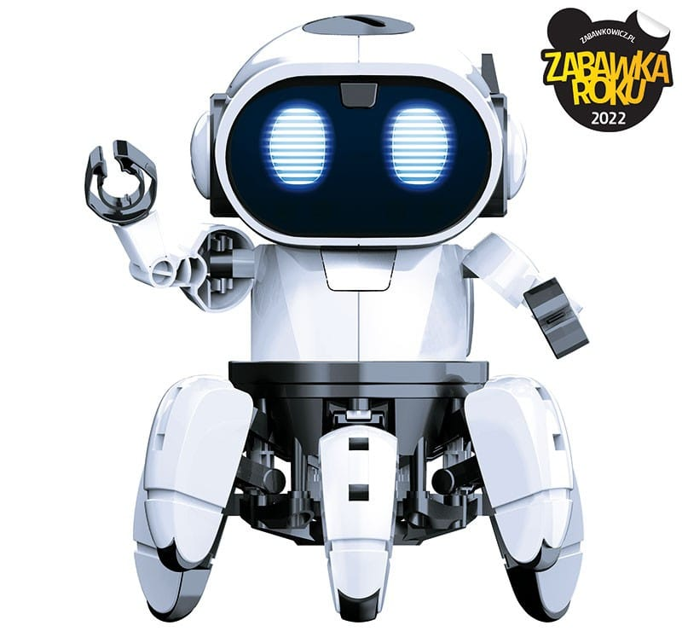
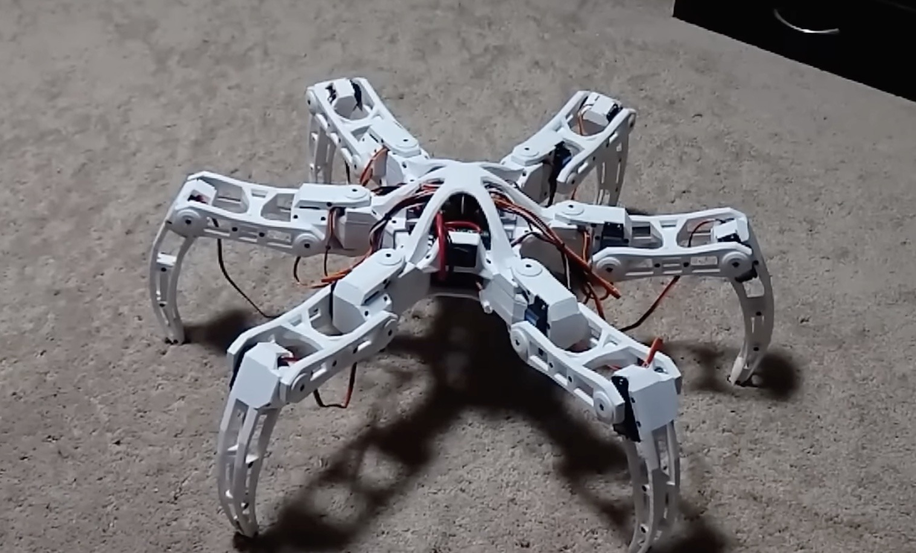
Hexapod
Features
3 (or 2!!) DoF
Remote controlled
Moves in all directions and rotates

Slide 2
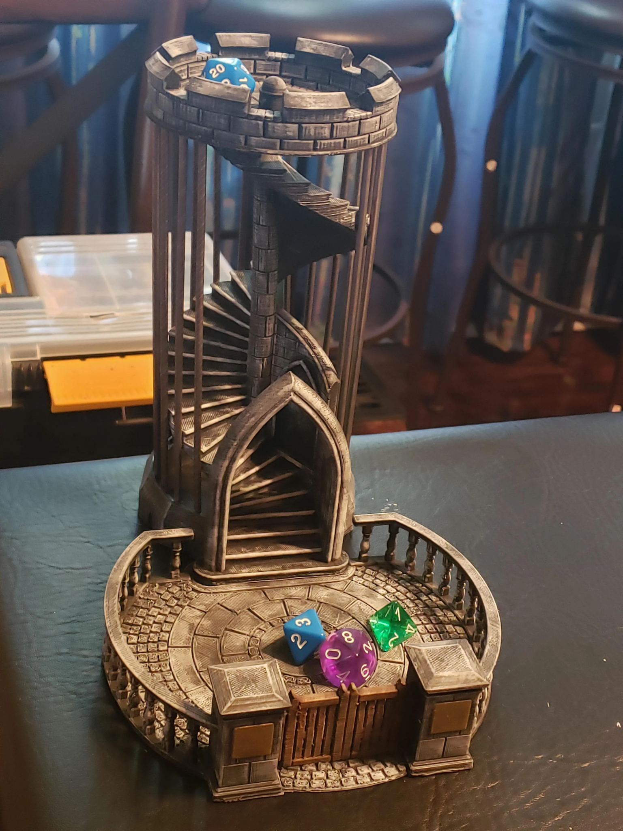
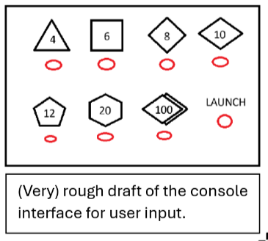
Dice tower
Features:
Throwing dice after user input
Getting them back
Readying them for the next throw
Potential extensions:
Linking the tower to an API
Reading results of the dice

Slide 3
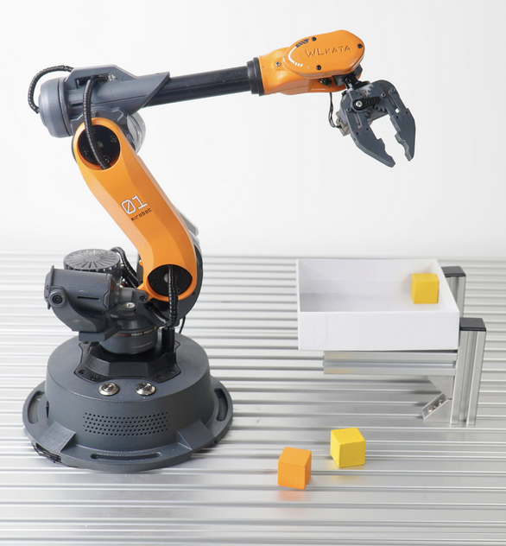
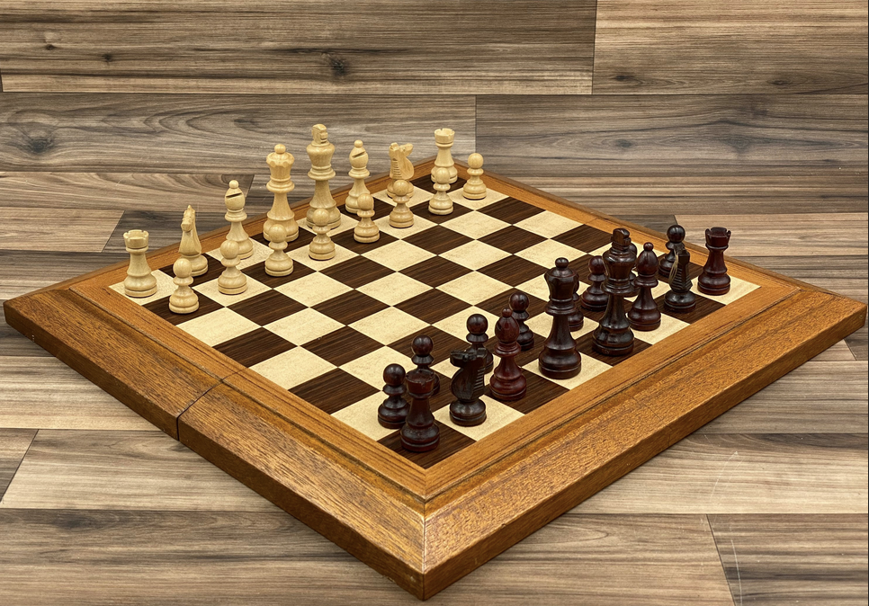
Chess-Playing Robot Arm
A robot arm system that can play chess against human opponents on a physical chess board
Robot arm connected to a personal computer that runs the chess engine and game logic
Computer vision for piece detection and board state tracking

Slide 4
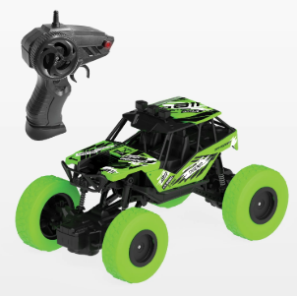
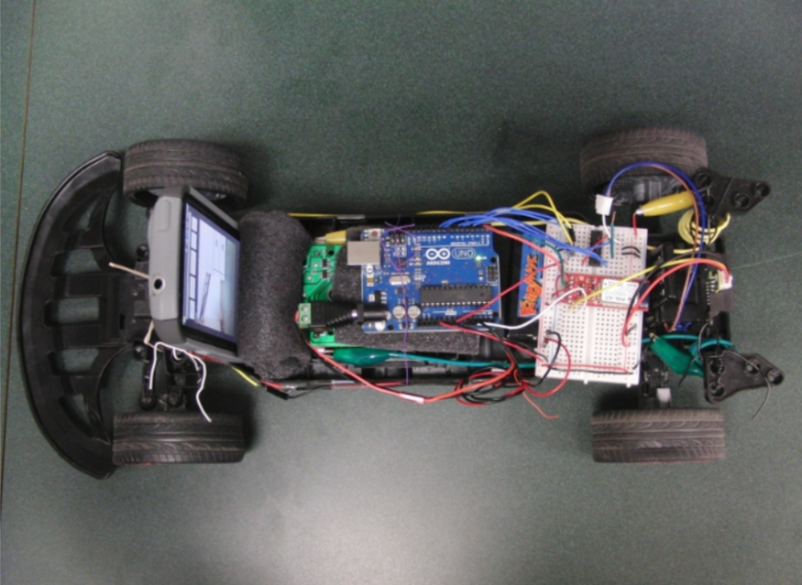
SLAM car
SLAM: Simultaneous Localization And Mapping
A remote controlled car modded to map and navigate the terrain around it
Saved terrain can either be continuously transmitted or saved locally
Students should reverse engineer the car
Add sensors etc.

Slide 5
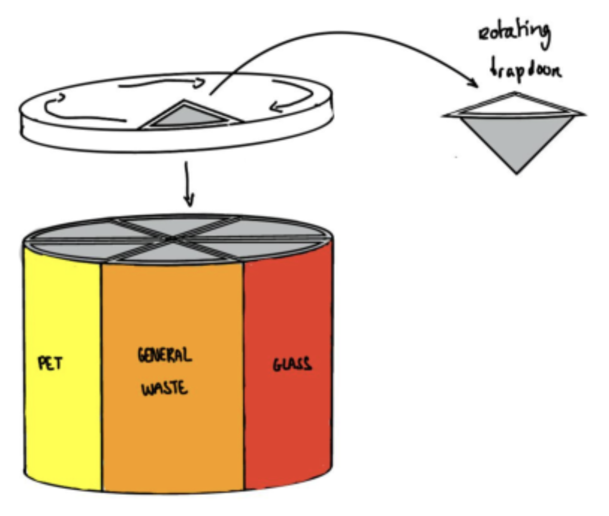
Automatic waste sorting bin
Bins for different types of waste
User puts waste on top
Detects type of waste
Rotates to align with the correct bin
Releases trapdoor to the waste

Slide 6
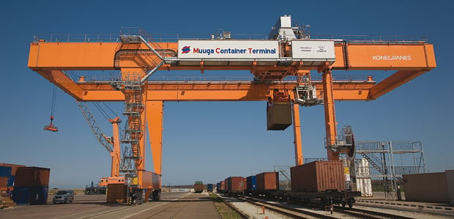
Train Container Terminal
Gauge 1 (1:32)

